Slide 1
Calculating the risks associated with radiation exposure
Alia Zander
December 15, 2016
Committee Meeting
Notes:
Hi everyone, thank you so much for agreeing to join my thesis committee and for being here to give your input on my project. Today I’ll be presenting on calculating the risks associated with radiation exposure

Slide 2
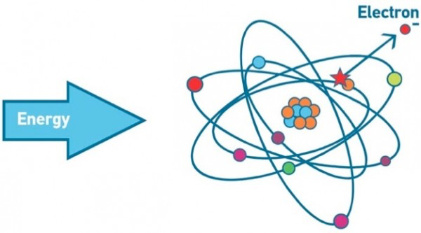
Ionizing radiation
Removal of electrons
Photon energy > 124eV
Wavelength < 10⁻⁶ cm
Linear energy transfer (LET) – energy transferred per unit length
High LET – alpha particles, neutrons
Low LET – x-rays, gamma rays, protons
Notes:
To start with some background, Radiation is categorized as non-ionizing, such as radio waves and heat waves, or ionizing radiation, such as x-rays and gamma rays. To be classified as ionizing radiation, the particles or photons must carry enough energy to liberate an electron from its orbit… this can be quantified as 124 electron volts or greater.
Electron Volts - It is the kinetic energy possessed by an electron when accelerated through a potential difference of 1 volt.
Within ionizing radiation, radiation can be measured by its linear energy transfer, which is the energy transferred per unit length. High LET is more damaging to biological material because DNA repair is more difficult for mutations within close proximity to one another. Alpha particles and neutrons are both high LET forms of ionizing radiation and x-rays, gamma rays, and protons are examples of low LET radiation.

Slide 3
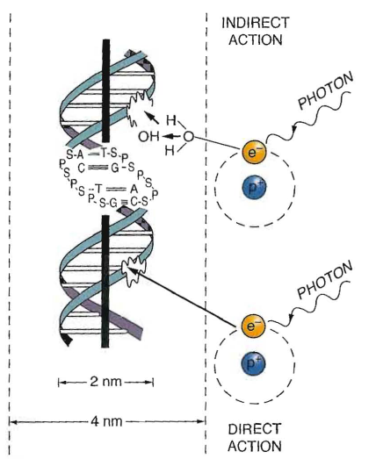
Ionizing Radiation Action
Indirect action – photon comes into contact with water molecule and creates hydroxyl intermediate that then damages DNA (neutrons, gamma-rays, x-rays)
Direct action – photon directly damages DNA (alpha and beta particles, protons, electrons)
Eric Hall, 6th edition
Notes:
Another important characterization of ionizing radiation is whether it works through direct or indirect action.
With indirect action, free radicals are produced which diffuse and cause damage. With direct action, the photon directly damages the DNA.
Indirect:
Free radicals are produced which diffuse and cause damage (Free radical: unpaired e- in outer shell)
Direct: Interaction directly with critical targets in the cell (DNA)

Slide 4
Radiation Injury
Early (Acute) Effects (radiation sickness)
Enzymatic DNA Repair
Cell Death
Late Effects
Direct
Ionizing Radiation
DNA Damage
Developmental Effects (fetal)
Ionization
DNA Mutation
Germline
Indirect
Heritable Effects
Free radical formation
Somatic
Malignant transformation
Eric Hall, 6th edition
CANCER
Notes:
After DNA damage through direct or indirect action from ionizing radiation, this damage can either get repaired properly, result in cell death (inability of a cell to properly divide – dicentrics or rings after ds breaks) or viable cells carrying DNA mutations.
Cell death can cause short term and long term issues and effect development of a fetus in a pregnant woman exposed to radiation
Aberrant repair can also lead to DNA mutations. If these mutations are in germline cells, it results in heritable effects. In somatic cells, it can lead to malignant transformation and cancer. Cancer will be the main focus of my thesis project and our discussion today.
Early – GI issues, lowered blood count
Late – sterility, lung fibrosis, clinical stuff

Slide 5
Radiation Injury
Early (Acute) Effects (radiation sickness)
Enzymatic DNA Repair
Cell Death
Late Effects
Direct
Ionizing Radiation
DNA Damage
Developmental Effects (fetal)
Ionization
DNA Mutation
Germline
Indirect
Heritable Effects
Free radical formation
Somatic
Malignant transformation
Eric Hall, 6th edition
CANCER
Notes:
Cancer will be the main focus of my thesis project and our discussion today.

Slide 6
Radiation measurements
Quantity | Unit | SI Unit | Relationship between units
Absorbed dose | Rad | Gray (Gy) | 1 Gy = 100 rad 1 Gy = 1 Sv
Equivalent dose | Rem | Sievert (Sv) | 1 Sv = 100 rem 1 rem = 1 rad * RBE (relative biological effectiveness)
Gray equals 1 joule of radiation energy per kg of material
Equivalent dose is modified from absorbed dose based on radiation types, dose rate, tissue weighting factors, etc.
Notes:
The last piece of helpful background information for us to go over on radiation in general is measurements. The SI unit for absorbed dose is Gray. I Gy equals one Joule of radiation energy per kilogram of material. This is typically used when discussing exposures.
The units for equivalent dose – often used when discussing protection – is in Sieverts.
Equivalent dose is modified from absorbed dose based on radiation types, dose rate, tissue weighting factors, and other factors.
So, why do we care about radiation risk so much?

Slide 7
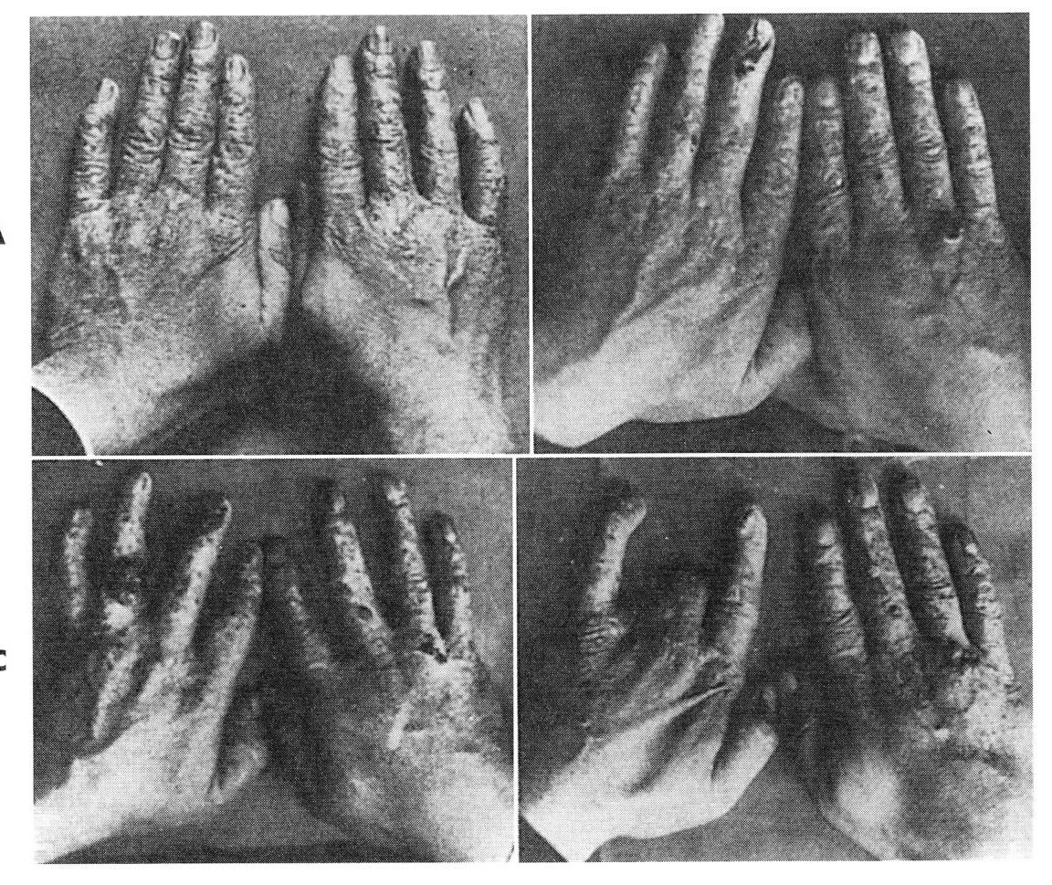
Significance for understanding risks associated with radiation
Appropriate policies
Improved protection
Reduce excess costs
Improved medical treatment/detection
Decreased fear of nuclear energy
Notes:
Understanding the risks of radiation exposure at different doses and dose rates is important for determining safe levels of exposure and the proper level of caution when considering general population exposures to ionizing radiation. ICRP report 103 – limits for general population and workers are 1mSv and 20mSv, respectively (lowered in 1991 after realization of stochasticity). If these values are too high, the population is in danger. If these values are too low, we are spending billions of dollars on radioactive waste disposal that could be better spent in other areas of research, there could be more medical tests used freely, and the stigma associated with nuclear energy and waste could be improved.
$35 billion dollars for nuclear waste fund as of 2012? 1.7 trillion dollars for DOE cleanup according to Berkley National Labs
http://www2.lbl.gov/LBL-PID/Galvin-Report/GalvinReport5.html#RTFToC34
http://www.forbes.com/sites/jamesconca/2014/07/13/absurd-radiation-limits-are-a-trillion-dollar-waste/#27a7ac20127d

Slide 8
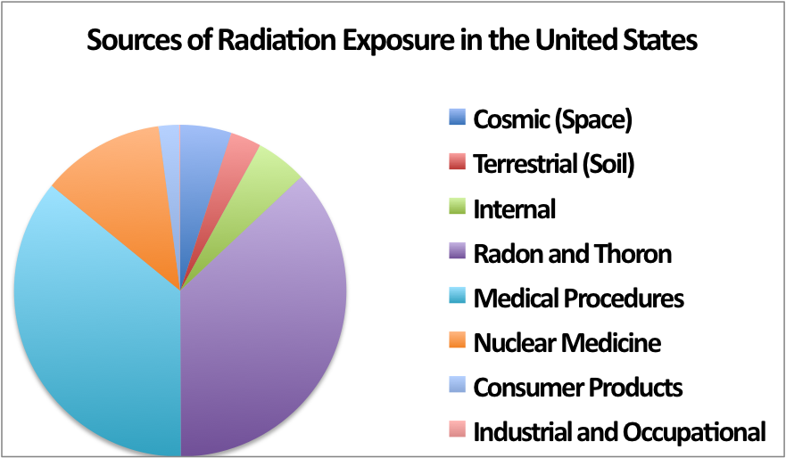
Average radiation exposure
Background levels of radiation every single day, typically less than 20 mSv at a time, accumulating to a few hundred mSv in a lifetime.
Man-made
Natural
National Regulatory Commission
Notes:
Radiation is unavoidable. Humans are exposed to background levels of radiation every single day, typically less than 20 millisieverts at a time, accumulating to a few hundred millisieverts in a lifetime [1]. Half of this radiation comes from natural sources like space and soil, while the other half is man-made used for nuclear medicine and medical procedures

Slide 9
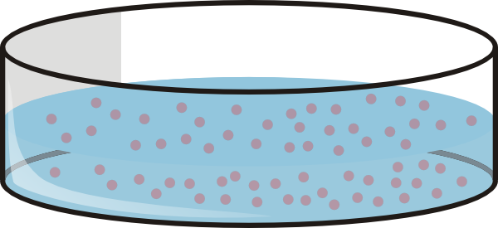
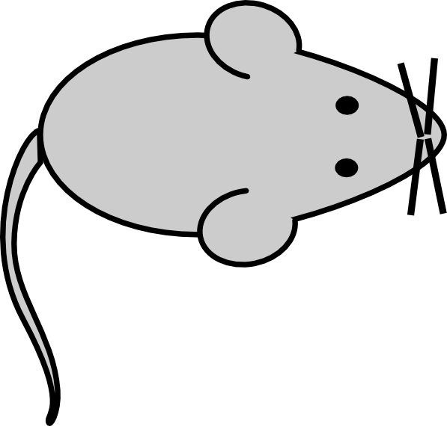

Types of radiation studies
Types of studies | Pros | Cons
 | Controlled experiment Economically advantageous Ease of genetic manipulation | Not as physiologically accurate
 | Controlled experiment Varying doses Varying dose rates Can test multiple species Ease of genetic manipulation | Not species of interest
 | Species of interest | Confounding factors Lack of ethnic diversity Small sample size Mostly acute exposures
Notes:
To understand how these low doses of radiation received at low dose rates are effecting our health, researchers use data from cell culture, animal studies, and epidemiological studies.
The pros and cons associated with cells under tissue culture are similar between radiation experiments and most other biological experiments – genetic manipulation, low costs, and good control are all advantages, but it’s not as physiologically accurate.
STOMACH, COLON, LIVER, LUNG, BREAST – substantially different between US and Japan
With radiation though, there’s also the comparison of animal experiments and human epidemiology.
Animal experiments have fewer confounding factors and the exact doses and dose rates can be set by the researcher. It’s also possible to test multiple species and genetically manipulate the animals. On the downside, the data is not from the main species of interest.
Epidemiology studies are most often used because humans are the main species of interest. However, the confounding factors such as genetic variability associated with these studies make it very difficult to find statistically significant changes in human health due to low doses of radiation. Furthermore, most data is from acute exposures to a distinct population, such as those affected by the atomic bombings in Japan.
Atomic bomb survivor data is the most popular data used for epidemiology studies. All of that data is on acute exposures and mostly high doses of radiation. To determine the effects of low dose and dose rates, we turn to the DDREF.

Slide 10
Dose and Dose Rate Effectiveness Factor (DDREF)
The DDREF quantifies the fold change in risk between acute and protracted radiation exposures.
Typically, a linear-quadratic formula is used to model radiation risk for DDREF calculations
Notes:
The dose and dose rate effectiveness factor – DDREF – quantifies that fold change in risk between acute and protracted radiation exposures. So if the DDREF is 2 – that means that acute exposures are twice as dangerous as protracted exposures.
To calculate overall risk, most often a linear-quadratic formula is used.

Slide 11
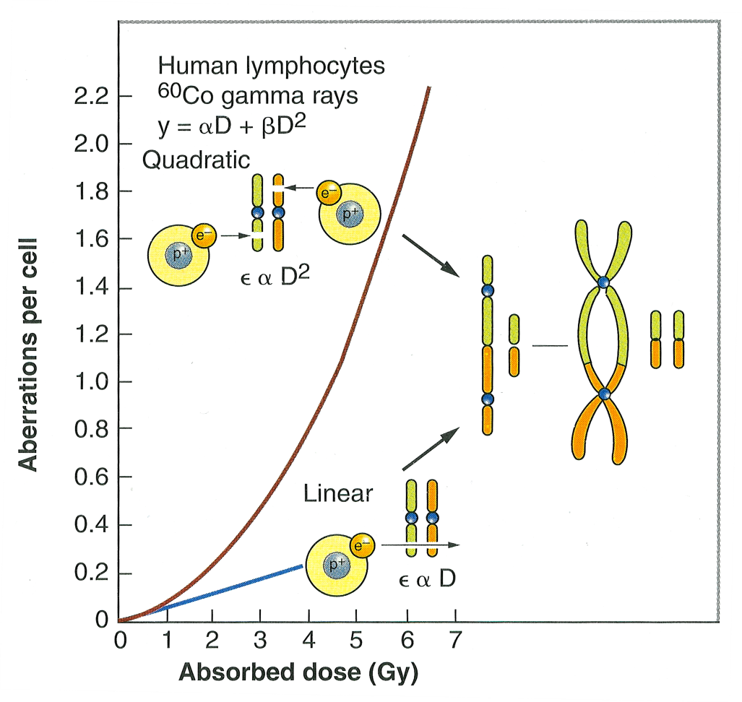
DDREF foundation
Eric Hall, 6th edition
Notes:
The linear-quadratic model is based on chromosomal aberration rates – the linear non-threshold model of cancer induction. These dicenrics occur after two separate breaks in the DNA. For lower doses, both breaks are most likely from the same electron, so the break frequency is proportional to dose. At higher doses, it’s most likely that the separate breaks are from separate electrons, making the break rate proportional to dose squared. The issue with using this reasoning for DDREF calculations is that dicentrics result in cell death, and dicentrics do not correlate with translocations or cancer. There are a lot of people in the field arguing against the linear quadratic model, and we have some information on this from our lab that I’ll touch on in a few slides.
FIGURE 2.20 The frequency of chromosomal aberrations (dicentrics and rings) is a Iinearquadratic function of dose because the aberrations are the consequence of the interaction of two separate breaks. At low doses, both breaks may be caused by the same electron; the probability of an exchange aberration is proportional to dose (D). At higher doses, the two breaks are more likely to be caused by separate electrons. The Q probability of an exchange aberration is proportional to the square of the dose (D²).
Mike Cornforth

Slide 12
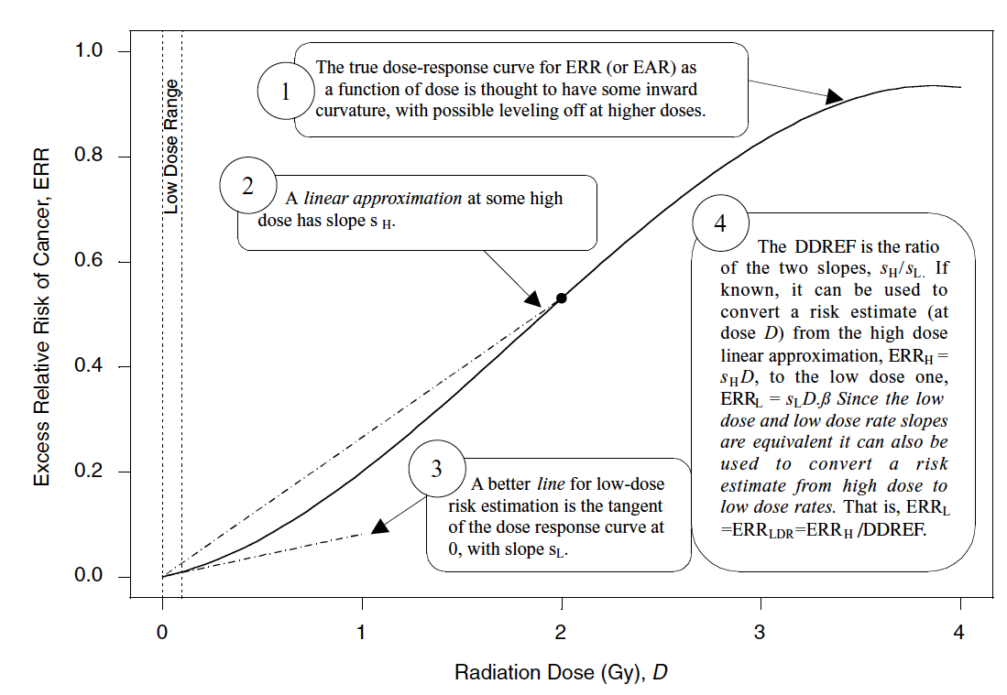
DDREF mathematically
BEIR VII
Notes:
Mathematically, the DDREF is the ratio of slopes for the high doses/low doses.
One is representing the true dose response, the linear quadtratic with some inward curvature and leveling off at higher doses
2. A linear approximation at some high dose
3. A linear approximation for the lose dose
4. DDREF is the ratio of the high dose slope/low dose slope
Which dose is used?????

Slide 13
DDREF estimates
Research Institution | DDREF Value
United Nations Scientific Committee on the Effects of Atomic Radiation (UNSCEAR) | 1.2-2.85 (2006) NA (2012)
SSK German Commission on Radiological Protection | 1
French Academy of Sciences | Very high
International Commission on Radiological Protection (ICRP) | 2.0
National Council on Radiation Protection (NCRP) | 2.0-10.0
National Academy of Sciences (NAS) - Biological Effects of Ionizing Radiation (BEIR VII) | 1.5
Notes:
So, there has been a lot of research done on DDREF estimates and this is a sample of some of the main findings. The United Nations Scientific Committee on the Effects of Atomic Radiation estimated a large range of 1.2-2.85 in 2006 and their most recent report concluded that they could not properly estimate. NCRP gives a range of estimates from 2-10. SSK German commision on Radiological Protection wants to abolish DDREF claiming it’s unneccessary, the value is one, there is no difference between risk in acute and protracted exposure. Biological Effects of Ionizing Radiation – BEIR VII was the 7th report in a seris from the National Research Council and our goal standard. They estimated a DDREF of 1.5 using atomic bomb survivor data and animal data

Slide 14
Biological Effects of Ionizing Radiation (BEIR VII)
3-12% increase in lethal cancer cases per Sievert of low dose rate or protracted ionizing radiation
Limited to crude analysis
No access to data
Some scientists no longer alive for reference to reproduce study
Notes:
Greatest impact on policy – 2006, last one was in 1990
A little more on BEIR VII – they concluded a 3-12% increase in lethal cancer cases per sievert of low dose rate or protracted ionizing radiation. Their analysis was crude, and it is difficult to reproduce because not all of the data is publicly accessable and the scientists that perfomred these studies are no long around for follow up questions. The large range of confidence from the BEIR VII and the additional mixed reports from other research institutions concluding that the risk is either higher or lower than BEIR VII’s estimate clearly demonstrates the need for further studies.
How old is BEIR VII, relevance
Talk more about the a

Slide 15
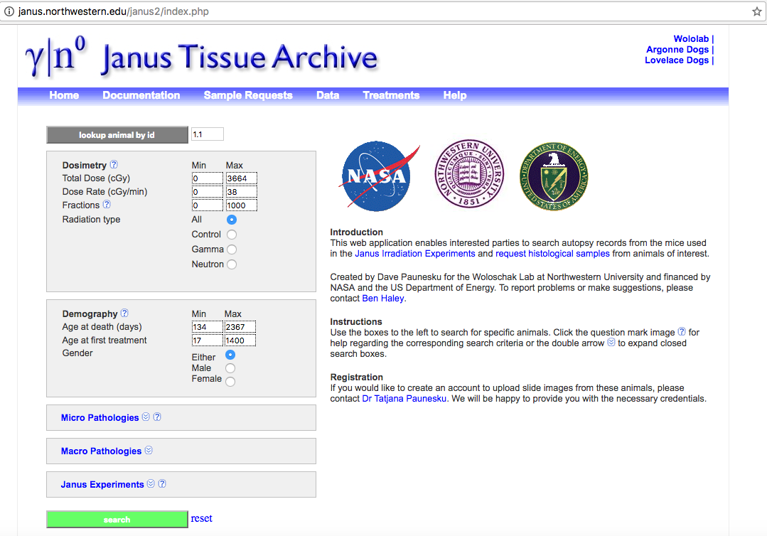
Janus Tissue Archive
Notes:
A phd student in the lab about to graduate, Ben Haley, began working to improve the BEIR VII estimate by including more data, and using a better statistical approach. Ben used data from the Janus Tissue Archive and European Radiobiology Archive. The Janus Tissue Archive includes 11 studies exploring the effects of neutron and gamma irradiation on 49,000 animals. Exposures were acute, fractionated, and protracted, and doses varied low to high.
Gamma ray doses 90-5,111cGy Cobalt 60 multiscource irradiator
Neutrons 1-470 cGy .85 MeV Janus reactor

Slide 16
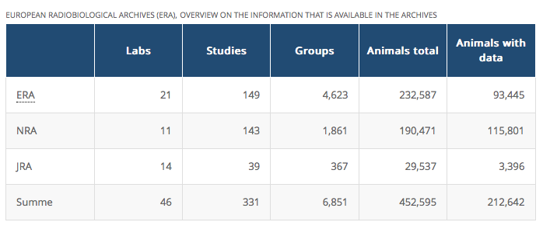
European Radiobiological Archives (ERA)
Notes:
National Radiobiology Archives
Japanese Radiobiology Archives
Studies between 1960-1998
ERA look into it – make sure animals died naturally

Slide 17
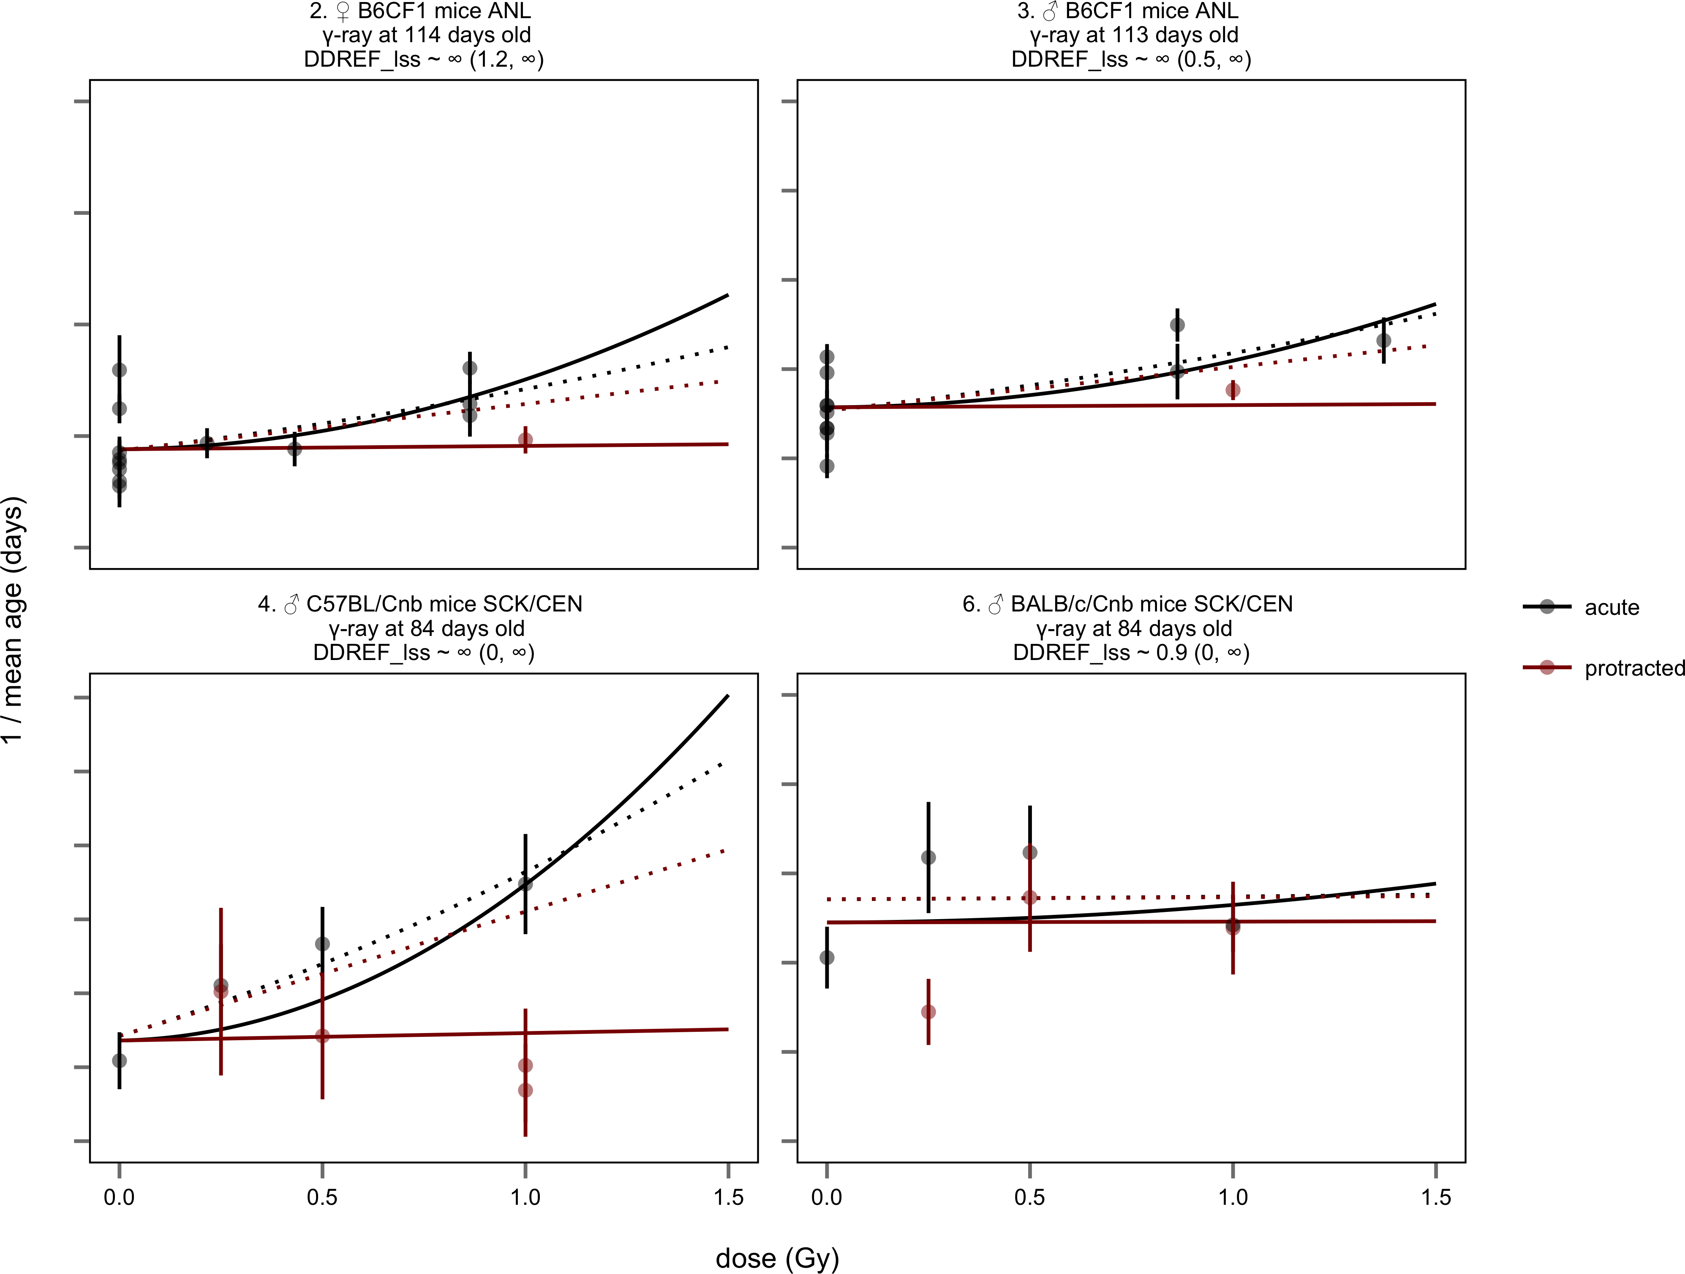
BEIR VII underestimates DDREF
Haley 2015
Notes:
To begin, Ben reproduced several key figures to prove that he was using the same modeling approach. This first figure shows 1/mean age on the y-axis (all of Ben’s work were lifespan studies) and dose in Gray on the x-axis. The black lines are acute exposures, the red lines are protracted exposures. When he added the extra animal data from Janus and ERA, he found that the DDREF was equal to infinity, meaning there is no risk from protracted exposures. We do not believe this is true, which led us to believe that the BEIR VII model was inaccurate. One way Ben tested this was looking at the 4 sets of Janus data where there was available data with matched acute AND protracted exposures. He compared a model that included both sets of data, to a model that only included acute data and used the linear quadratic model to extrapolate proctracted exposures. Doing this shows that the BIER VII model, the dotted lines, underestimates DDREF consistently. That means we are overprotecting, wasting billions of dollars on radioactive waste disposal.
BEIR VII approach – DDREF of .9 to 3.0
Ben’s approach with acute and protracted – DDREF 4.8 to infinity

Slide 18
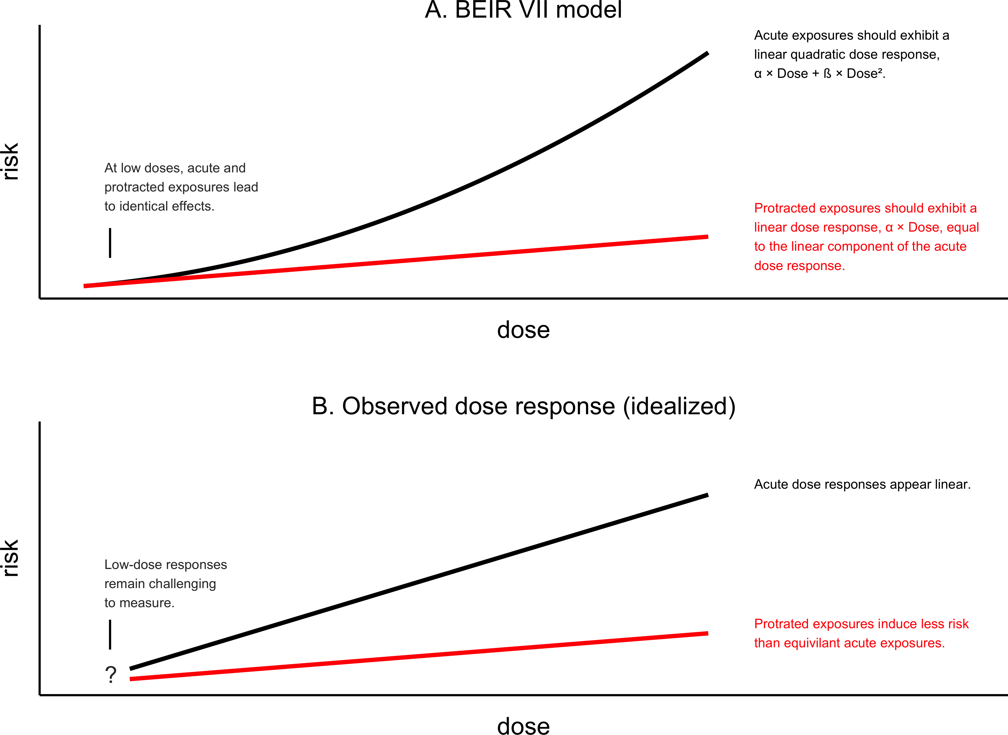
Linear-linear models fit the data better than linear-quadratic models
Haley 2015
Notes:
Additionally, another major flaw that Ben found in the BEIR VII model was the use of a linear quadratic. For many cases, a linear linear model with different slopes for acute and protracted exposures, fit the data much better than the linear quadratic.
There is clearly a lot more research needed to understand the risks associated with radiation exposures and how to quantify this risk.

Slide 19
Thesis research project
Hypothesis: Human radiation risk estimates can be improved through rigorous statistical modeling with large, detailed mouse data sets that include protracted and acute dose data.
Aim 1: Calculate DDREF using lethal cancer endpoints from mice treated with varying radiation exposures.
Aim 2: Determine if harderian gland tumor (benign) formation in response to radiation exposure is a proper representative model for other cancer types.
Notes:
We hypothesize that… blah blah
To do that, we aim to specifically calculate DDREF using lethal cancer end points from mice treated with varying radiation exposures.

Slide 20
Thesis research project
Hypothesis: Human radiation risk estimates can be improved through rigorous statistical modeling with large, detailed mouse data sets that include protracted and acute dose data.
Aim 1: Calculate DDREF using lethal cancer endpoints from mice treated with varying radiation exposures.
Aim 2: Determine if harderian gland tumor (benign) formation in response to radiation exposure is a proper representative model for other cancer types.
Notes:
We will start with aim 1 –
Cancer is the number one risk associated with radiation and therefore, it’s important to understand how radiation plays a role specifically in cancer induction

Slide 21
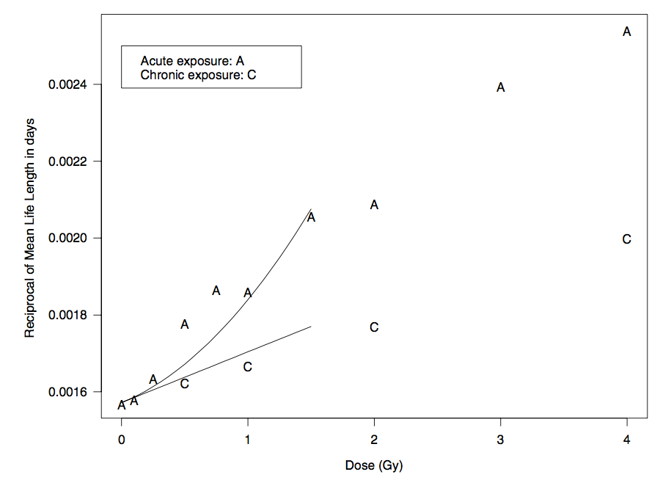
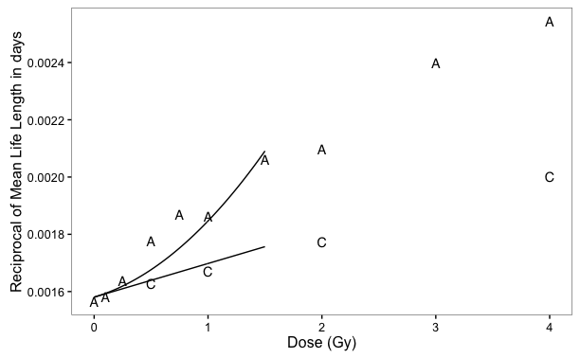
Reproducing important figures from BEIR VII as a benchmark
BEIR VII’s model
My reproduction
BEIR VII
Notes:
Similar to Ben’s approach, I will be first using BEIR VII as a benchmark. The y-axis shows the reciprocal of life length and the x-axis is dose.

Slide 22
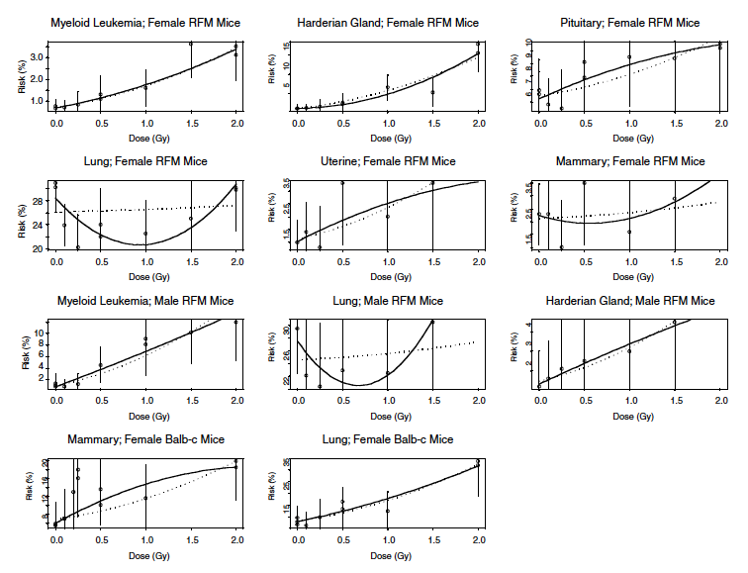
BEIR VII cancer associated DDREF
BEIR VII
Notes:
BEIR VII also created cancer models and this will be the next figure that I work to reproduce before delving into cancer associated DDREF with my own data set. The y-axis represents Risk percentage and the x-axis is Dose. Discuss stratification – sex specific cancers, strain
Cutoff makes a big difference – redoing dosimetry
WHAT DDREF did they come up with???

Slide 23
Work flow
Data validation and filtering
Data stratification
Linear-quadratic modeling
Calculating credible intervals
Calculating DDREF
Examining alternative models
Notes:
So, after reproducing those figures to prove that I am faithfully using their model, I will use data from Janus and ERA to create an improved model

Slide 24
Work flow
Data validation and filtering
Data stratification
Linear-quadratic modeling
Calculating credible intervals
Calculating DDREF
Examining alternative models

Slide 25

Inclusion criteria
Individual-level animal data available
External radiation exposures
Low – LET, whole body exposures
Total dose equal to or below 2 Gy
No other treatments (e.g. no chemical exposures)
Digitized data on treatment and cancer incidences confirmed by primary literature
Cancer associated cause of death
At least three distinct treatment groups per stratum so that a linear-quadratic model can be fitted

Slide 26


Work flow
Data validation and filtering
Gender
Data stratification
Age
Strain
Linear-quadratic modeling
Calculating credible intervals
Calculating DDREF
Examining alternative models
Notes:
We will stratify the data by gender, age, and strain. It has already been shown that the younger someone is at exposure, the more likely they are to develop cancer because there is more time left for cancer to develop.
We also know that women are more sensitive than men and that some strains are more sensitive, such as balb/c mice, and some are more resistant, like C57 mice
WHICH TYPES OF MICE?

Slide 27
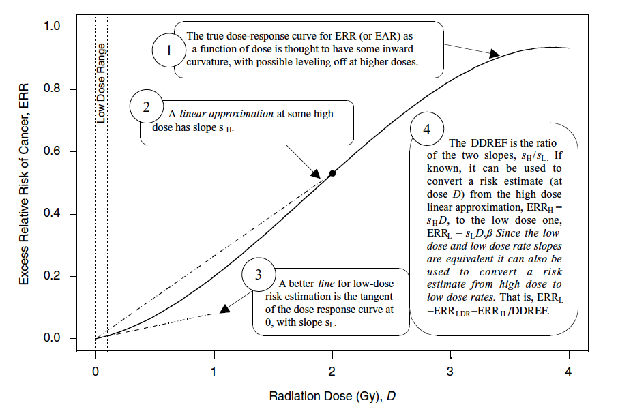
Work flow
Data validation and filtering
Data stratification
Linear-quadratic modeling
Calculating credible intervals
Calculating DDREF
Examining alternative models
Notes:
I already described the mathematics involved with linear quadratic modeling and this process will be done using R for all statistical models.

Slide 28
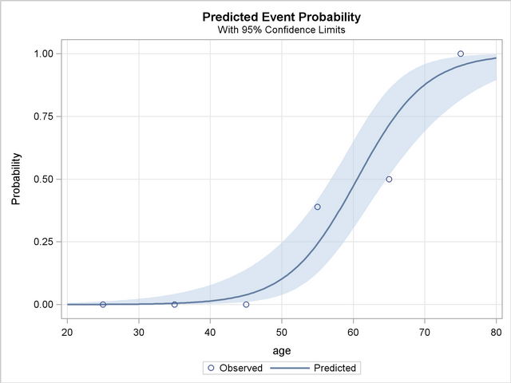
Work flow
Data validation and filtering
Data stratification
Linear-quadratic modeling
Profile likelihood estimates
Calculating credible intervals
Calculating DDREF
Examining alternative models
Notes:
Calculating the credible intervals is also key for data analysis. All models are done through maximum likelihood estimations and we will derive profile likelihood estimates to go with it.

Slide 29
Work flow
Data validation and filtering
Data stratification
Linear-quadratic modeling
Calculating credible intervals
Calculating DDREF
DDREF = 1+β/α*Dose
Examining alternative models
Notes:
Once all of that is done, calculating DDREF will be a breeze – as a refresher it’s just 1 + b/a * dose
Which dose for DDREF?
in theory is figure our DDREF across the of atomic bomb survivor doses and then apply the correction to each point in the range. This will lead you do a straight line that represents the risk of protracted exposure. BEIR VII showed that doing that exact method is basically the same as finding the correction at 1Gy and applying it across the range. They have a table that shows that off and you can confirm with your own experiments.

Slide 30
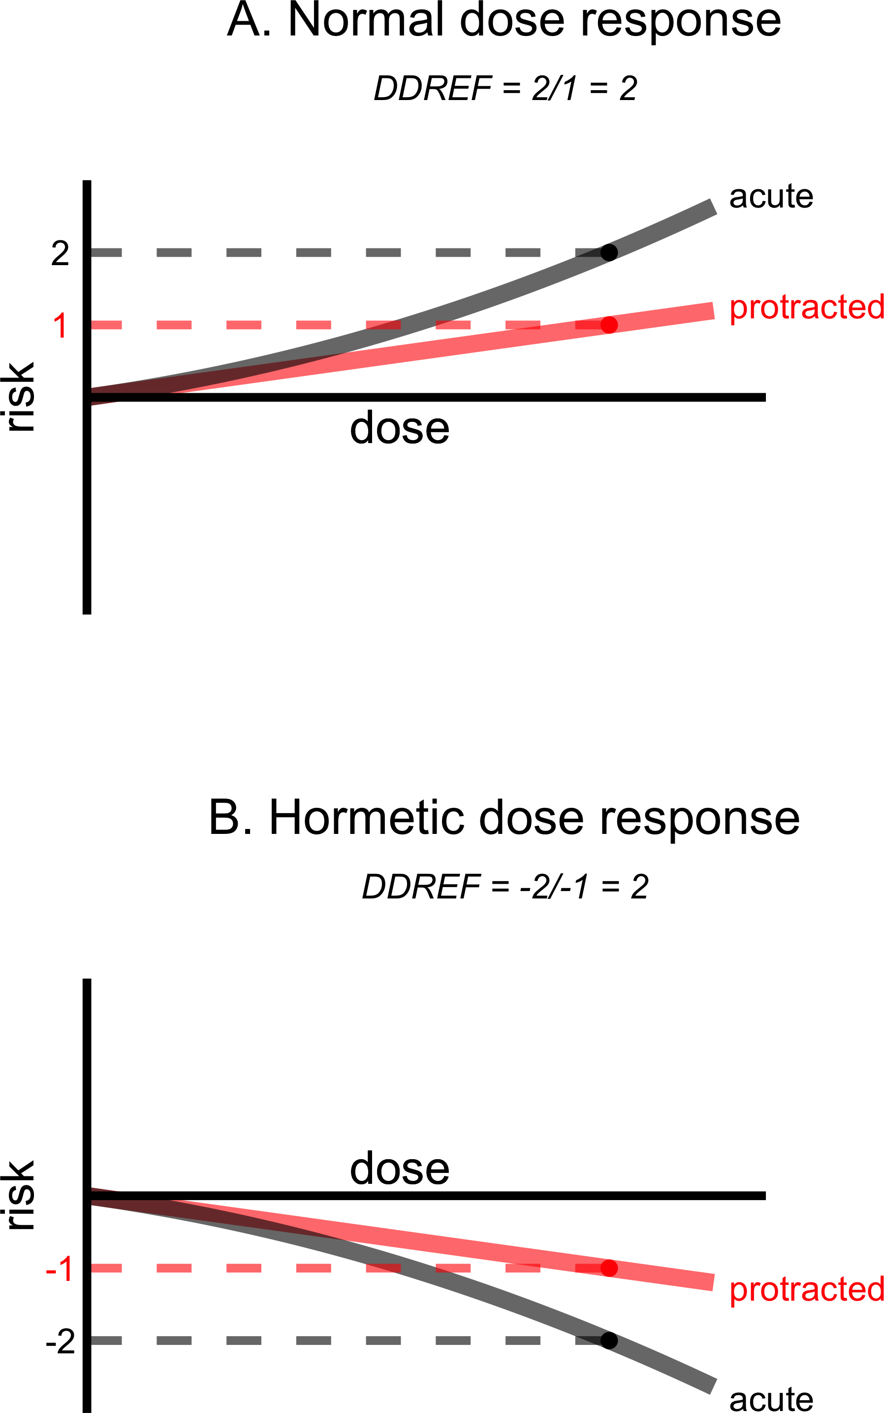
Work flow
Data validation and filtering
Data stratification
Linear-quadratic modeling
Calculating credible intervals
Calculating DDREF
Eliminate hormesis
Examining alternative models
Linear-linear
Include heterogeneity
Notes:
Lastly, similar to Ben, I will explore some alternative models to BEIR VII that could improve DDREF estimates.
One will be eliminating hormesis - DDREF based on detrimental effect – Ben had 2/15 with hormesis, if there were more it would be more evidence against DDREF calculations
Another will be including heterogeneity in the model. This is a very common technique necessary for meta analysis studies that BEIR VII did not include in their crude analysis.
Heterogeneity – include random effects – systematic sources of variance that affect entire treatment groups – estimate unmeasured variance between treatment groups

Slide 31
Thesis research project
Hypothesis: Human radiation risk estimates can be improved through rigorous statistical modeling with large, detailed mouse data sets that include protracted and acute dose data.
Aim 1: Calculate DDREF using lethal cancer endpoints from mice treated with varying radiation exposures.
Aim 2: Determine if harderian gland tumor (benign) formation in response to radiation exposure is a proper representative model for other cancer types.
Notes:
Moving on to aim 2 – determing if harderian glad tumor formation in response to radiation exposure is a proper representative model for other cancer types

Slide 32
Harderian gland tumors
The harderian gland is located on the posterior surface of the eyeball and is well developed in animal species that possess a third eyelid
The nictitating membrane (third eyelid) is transparent and covers the eye for protection, moisture, and vision purposes
These tumors are nonlethal, but induced by radiation

Slide 33
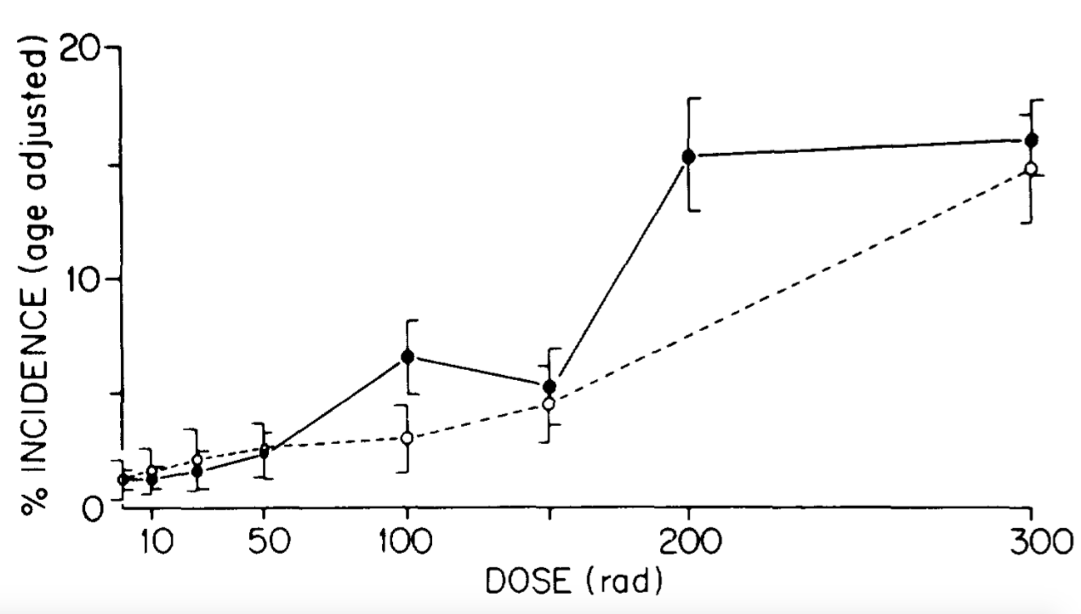
Harderian gland tumors
Harderian gland is commonly used to better understand the relationship between cancer incidence and low LET radiation
Male –open circles
Female –closed circles
Ullrich and Storer 1979
Notes:
This is an example – Ullrich and Storer from 1979 examining male (open circles) and female (closed circles) RFM mice as a function of radiation dose. This data was used in BEIR VII analysis. Linear-quadratic, but linearity could only be excluded with confidence from female mice.

Slide 34
Harderian gland concerns
Not present in humans
Non-lethal
Shows trend similar to leukemia, not solid tumors
X
X
Notes:
I’ve shown you this figure before, but it’s important to note here that the solid lines are fits for individual data sets. The dashed line is a fit using a fixed theta value. Theta is the beta over alpha ratio. While beta and alpha can each vary from cancer type to cancer type, in order to calculate one final DDREF, they used a fixed ratio. The fact that Harderian glands fit this trend so well is one of the reasons it is so commonly used to represent radiation risk. That doesn’t mean that it’s an accurate representation
Do not use thymic and ovarian – highly sensitive
Do not use pituitary – associated with ovary

Slide 35
Work flow
Individual cancer types
Create function to test multiple models
Statistical tests to identify which models fit best
Notes:
So, how do we plan to test the suitability of harderian glad models? We plan to carry out several comparisons between harderian gland tumors and other cancer types.

Slide 36
Work flow
Individual cancer types
Create function to test multiple models
Statistical tests to identify which models fit best
Notes:
We will begin by looking at individual cancer types. Similar to BEIR VII, we can compare best fits with a fixed theta and a variable theta using a likelihood ratio test.

Slide 37
Work flow
Individual cancer types
Benign vs. lethal
Create function to test multiple models
Harderian vs. myeloid
Harderian vs. solid tumors
Statistical tests to identify which models fit best
Harderian vs. all others
Notes:
From there, we will create a function that allows us to compare multiple models. We will check differences between benign vs. lethal, harderian vs. myeloid, harderian vs. solid tumors, harderian vs. all other tumors, and anything else that may appear to be informative after the previous analyses have been completed.

Slide 38
Work flow
Individual cancer types
Create function to test multiple models
Likelihood ratio test
DDREF calculations
Statistical tests to identify which models fit best
Confidence intervals
Cross Validation
% variability
Notes:
From there, we will create a function that allows us to compare multiple models. We will check differences between benign vs. lethal, harderian vs. myeloid, harderian vs. solid tumors, harderian vs. all other tumors, and anything else that may appear to be informative after the previous analyses have been completed.

Slide 39
Timeline for goals
Aim 1
Aim 2
4-6 months
Data validation and filtering
Data stratification
Individual cancer types
2-3 months
2-4 months
Linear-quadratic modeling
Create function to test multiple models
2-3 months
Calculating credible intervals
Statistical tests to identify which models fit best
2-3 months
Calculating DDREF
Examining alternative models
1-2 months

Slide 40
Milestones
Publications and presentations
Hanh Chi Do-Umehara et al. Suppression of inflammation and acute lung injury by Miz1 via repression of C/EBP-[delta]. Nature Immunology.
Pulmonary Symposium – poster presentations 2014 and 2015
Pulmonary and Critical Care Division Symposium – Research in progress presentation 2014
Radiation Research Society – poster presentation 2016
Awards
NSF Reach For the Stars GK12 Fellowship
Katten Muchin Rosenman Travel Scholarship

Slide 41
Development
Radiation Research Society Conference
Radiation Biology course
Online courses
R programming
Statistical inference
Regression models
Bayesian Statistics
Meta analysis – Statistics Department Chair
Kellogg Management Program for Scientists and Engineers
NCRP meeting next year
Writing course

Slide 42
Conclusion
Increased certainty in the risks caused by radiation exposure will allow the proper level of caution to be taken for radiation exposure guidelines and policies regulating worker exposures at nuclear power plants, nuclear waste disposal sites, decisions on use of medical diagnostics instruments that produce ionizing radiation, and thresholds for workers in the field in an effort to decrease cancer development.

Slide 43
Questions?

Slide 45
Summary
A variety of human populations have been used to estimate cancer risks from radiation exposure.
Risks are age-dependent at the time of exposure and dose- and dose-rate dependent
Radiation has been associated with the development of some secondary malignancies in the field
A variety of different national and international agencies are charged with assessing the risks of radiation exposure as they relate to cancer induction.

Slide 46
Major Human Population Exposures
1. Japanese A-bomb
- very important group for risk estimates
- 120,000 people followed long term
- registry of exposures
no + γ-rays → precise dosimetry gave rise to ↑ risk estimates of cancer
2. Alkylosing Spondylitis
- x-radiotherapy to spine--↑ leukemia
-Radium salt injections—bone tumors
Thymus enlargement radiotherapy – radiotherapy lead to ↑ thyroid cancer
Radiotherapy for adenoids, tonsils—thyroid cancer
5. Tinea capitis (immigrants from N. Africa to Israel)
- x-ray treatment of scalp for fungus
→ thyroid cancer
→ skin cancer
Also had meningiomas, other brain tumors, leukemia, salivary gland tumors
American experience had lower incidence of tumors: thyroid, skin
Fluoroscopy of TB patients - ↑ breast cancer
Thorotrast patients--Liver tumors
Thorotrast (contrast material for x-rays) – radioactive Thorium α-particles
8. Peptic ulcer—patients irradiated for peptic ulcer, higher risk for stomach cancer in those getting <10Gy
Notes:
Never with doses over 10 Gy for stomach cancer (8)

Slide 47
Data analysis methods | Reasoning
Eliminate hormetic paradox | Linear-quadratic model founded by chromosomal aberrations – does not allow for hormetic effects
Account for heterogeneity between treatment groups | Random effects model is preferred to account for variation between and within studies
Stratification by study | Data was already stratified by strain, sex, and age at exposure in BEIR VII. Stratification by study will take into consideration differences in cage crowding, pathogen environment, ambient temperature, etc.
Survival | Model mortality using Cox proportional hazards model – described by a baseline hazard over time and explanatory covariates

Slide 48
Major findings to date
Types of studies | Major source of data | Major findings
 | ERA Janus Lovelace
 | Atomic bomb survivors Uranium miners US nuclear tests Chornobyl Thyroid cancer after external radiation Nuclear industry workers Medical personnel

Slide 49
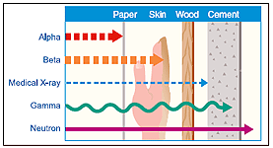
Types of ionizing radiation
Particulate – protons, neutrons, electrons, alpha and beta particles
Electromagnetic – gamma rays and x-rays

Slide 50
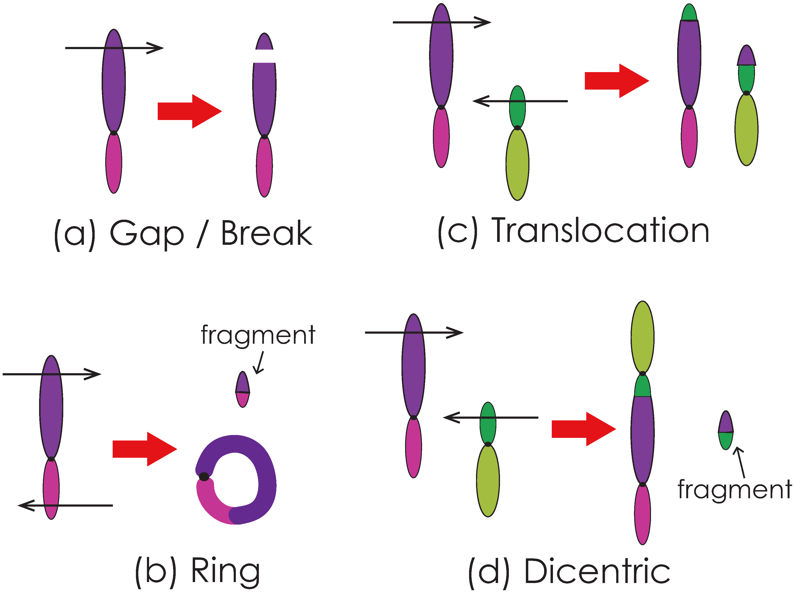
Radiation induced chromosomal aberrations
Base damage
ssb
dsb
mds
Notes:
Remove?

Slide 51
